Slide 1
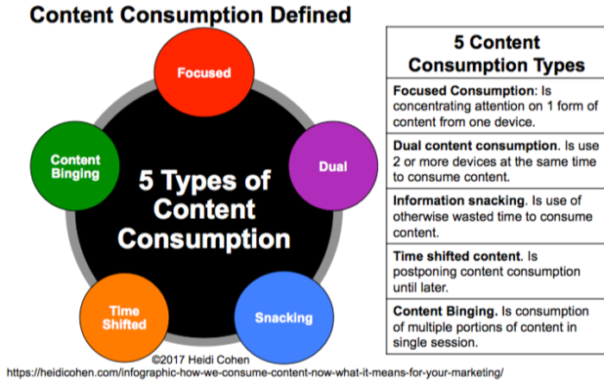
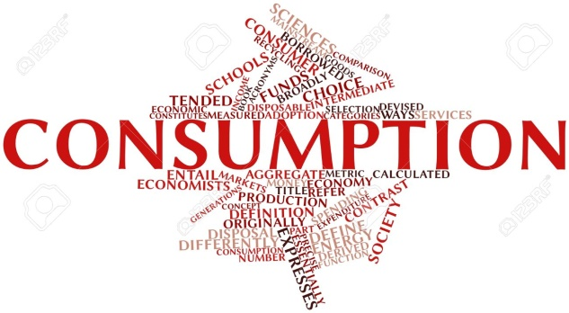
Consumption (economics)

Slide 2
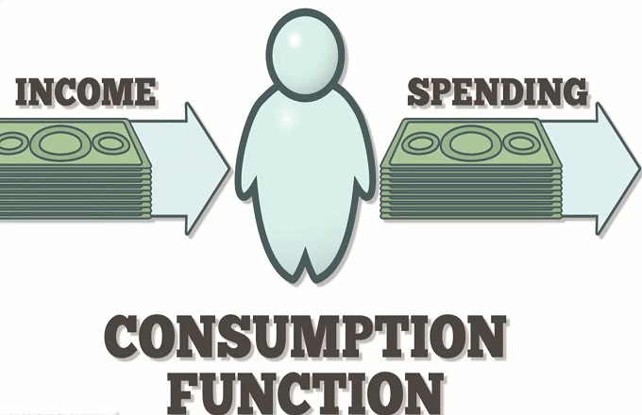
Definition
Consumption, defined as spending for acquisition of utility, is a major concept in economics and is also studied in many other social sciences. It is seen in contrast to investing, which is spending for acquisition of future income.

Slide 3

Consumption and household production
Aggregate consumption is a component of aggregate demand. Consumption is defined in part by comparison to production. In the tradition of the Columbia School of Household Economics, also known as the New Home Economics, commercial consumption has to be analyzed in the context of household production. The opportunity cost of time affects the cost of home-produced substitutes and therefore demand for commercial goods and services. The elasticity of demand for consumption goods is also a function of who performs chores in households and how their spouses compensate them for opportunity costs of home production.

Slide 4
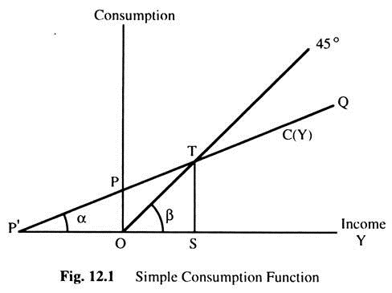
Behavioural economics, keynesian consumption function
The Keynesian consumption function is also known as the absolute income hypothesis, as it only bases consumption on current income and ignores potential future income (or lack of). Criticism of this assumption led to the development of Milton Friedman's permanent income hypothesis and Franco Modigliani's life cycle hypothesis. More recent theoretical approaches are based on behavioral economics and suggest that a number of behavioural principles can be taken as microeconomic foundations for a behaviourally-based aggregate consumption function.

Slide 5
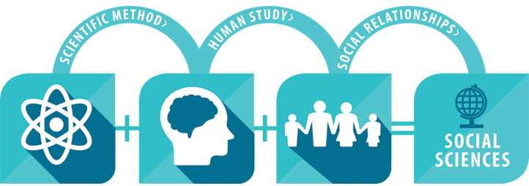
Social science
Social science is a category of academic disciplines, concerned with society and the relationships among individuals within a society. Social science as a whole has many branches. These social sciences include, but are not limited to: anthropology, archaeology, communication studies, economics, history, musicology, human geography, jurisprudence, linguistics, political science, psychology, public health, and sociology.

Slide 6

Conclusion
The process in which the substance of a thing is completely destroyed, used up, or incorporated or transformed into something else. Consumption of goods and services is the amount of them used in a particular time period.

